Slide 1
DEEP LEARNING MODELS FOR EMOTION RECOGNITION FROM FACIAL EXPRESSION IMAGES
Master’s Diploma Thesis DEFENSE
Student: AndrA Umoru
Thesis supervisor: dr hab. inż. jerzy balicki, prof. ucz.
16.11.2023

Slide 2

OUTLINE
Introduction & thesis goal
Datasets & CNN Models
Results Analysis
Future Directions
References
Metrics of Learning
Remarks & Conclusion

Slide 3
Introduction
Deep learning has found applicability in different domains of human activities, one of which is Facial Emotion Recognition, as argued by Huang [1].
According to Cîrneanu [2], Facial emotion recognition (FER) is a computer vision process that aims at detecting and classifying human emotional expressions.
Zhang [3] and Afzal [4] opined that emotion recognition using facial expression images has been a fascinating field of study in computer science, psychology, and artificial intelligence.

Slide 4
Thesis Goal
Build a DL Model for Emotion Recognition (CNN).
Four (4) facial expression image datasets
Proposed Model (TensorFlow vs PyTorch)
Proposed Model vs ResNet, SANet and VGG
1
4
2
3

Slide 5
Datasets – CK +
CK+ Dataset - 7 Emotions
- 981 images of 123 people
- Size (48, 48)

Slide 6
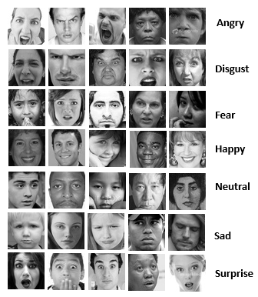
Datasets – FER2013
FER2013 dataset
- 7 emotions
- 35,887 grayscale images
- Size (48, 48)

Slide 7
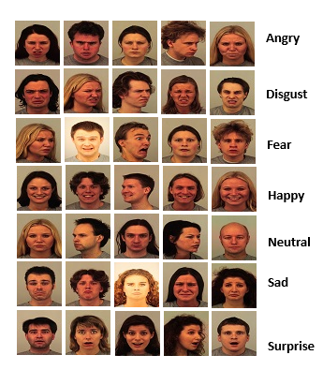
Datasets – Karolinska
Karolinska
- 7 emotions
- 2938 images
- RGB images of size (562, 762)

Slide 8
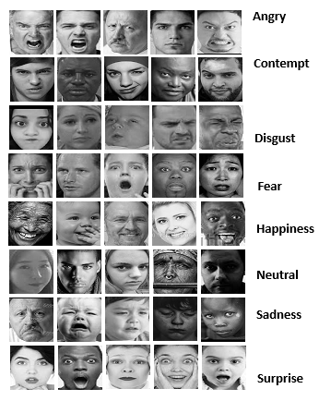
Datasets – NHFI
Natural Human Face Dataset
- 8 emotions
- 5558 grayscale images
- Size (224, 224)

Slide 9
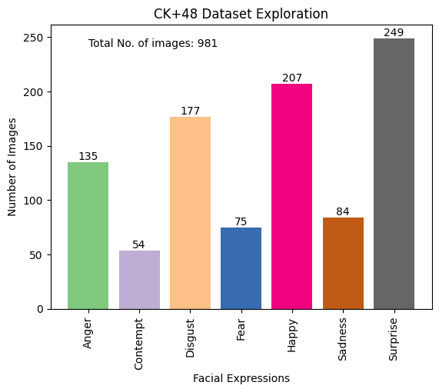
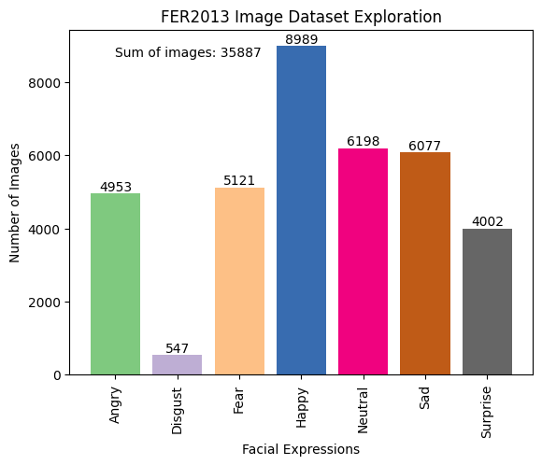
Datasets – Exploration…

Slide 10
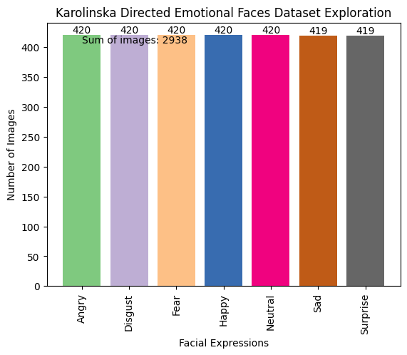
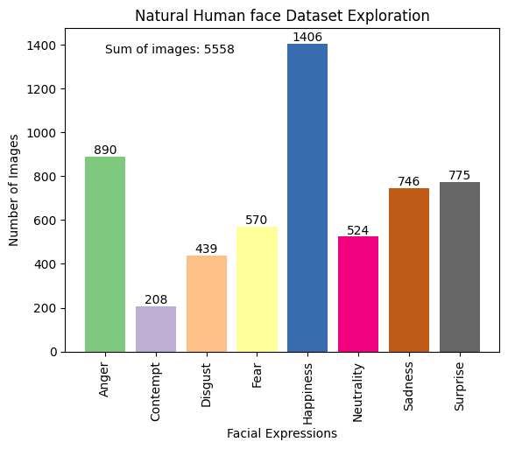
Datasets - Exploration

Slide 11
CNN Models
The Proposed Model (TensorFlow & PyTorch)
1
SANet Model
- Skip concatenation
- Attention Mechanism
2
VGG Model
- Oxford Univ. (2014)
- Deeper Network with smaller filters
- VGG-16 & VGG-19
3
ResNet Model
- Exploding Gradient
- Residual block
- Skip connections
- ResNet50
4

Slide 12
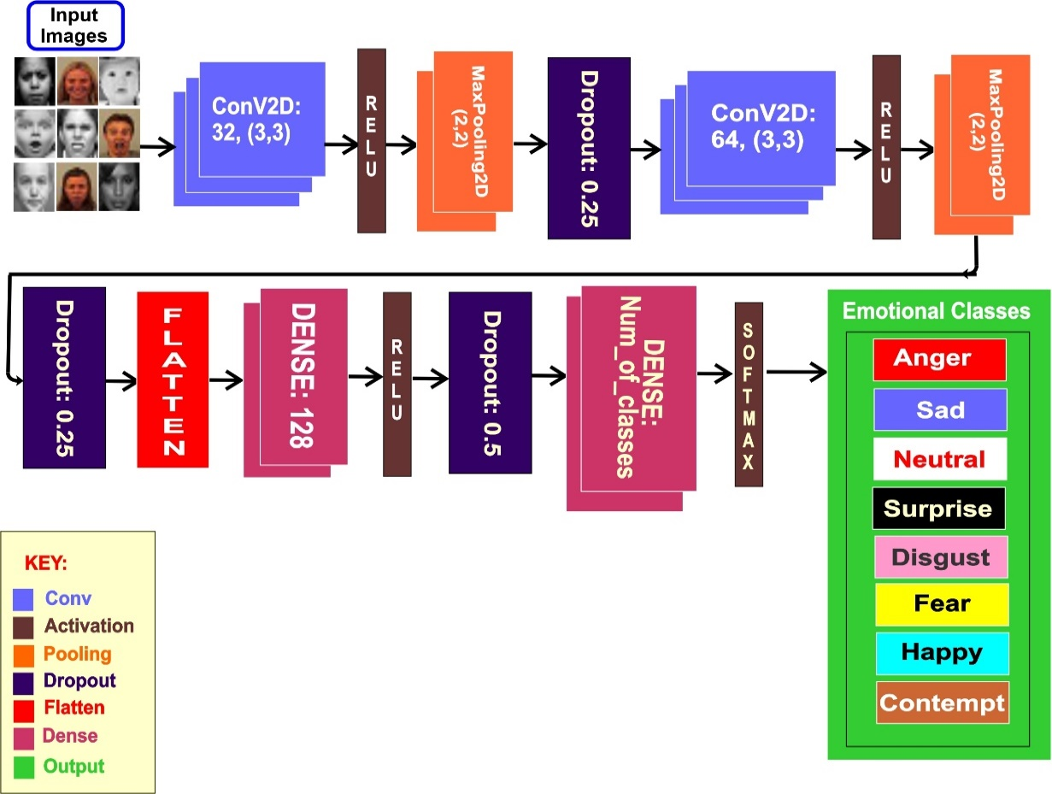
Proposed Model of CNN Architecture

Slide 13
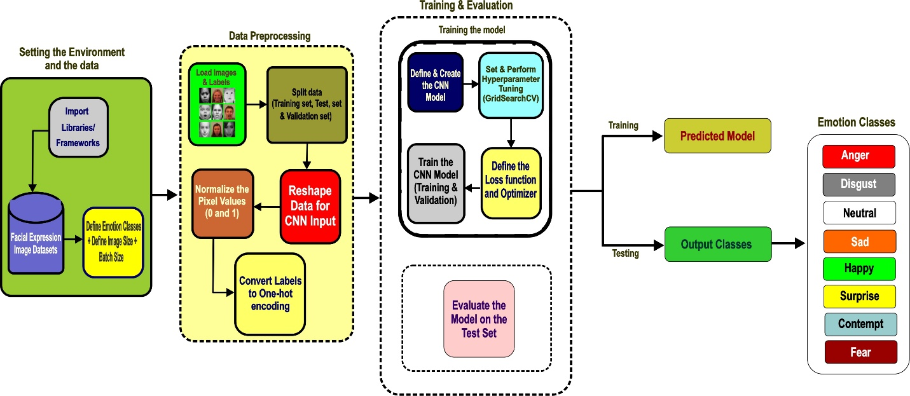
Proposed Model Workflow (TensorFlow)

Slide 14
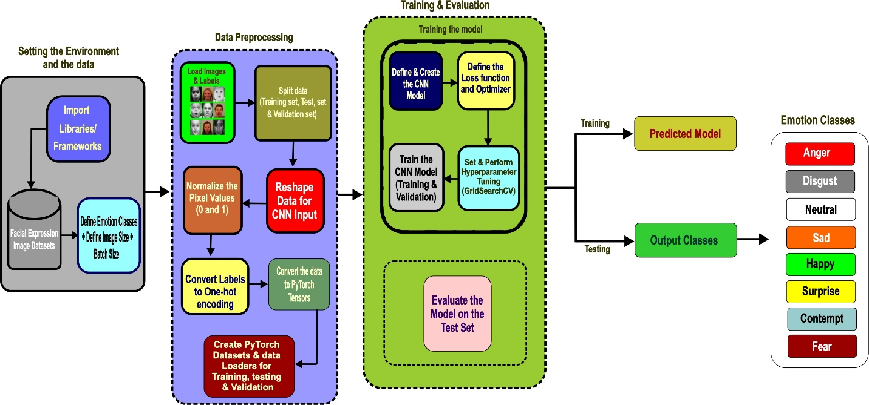
Proposed Model Workflow (PyTorch)
PyTorch

Slide 15

Metrics of Learning
Accuracy
F1 Score
AUC ROC
Training & Evaluation time
Memory Usage

Slide 16
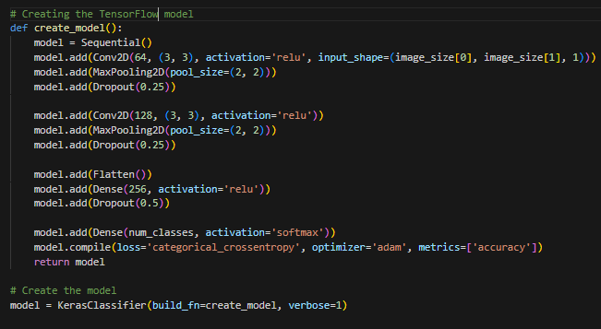
Some Sample Code – (TensorFlow)

Slide 17
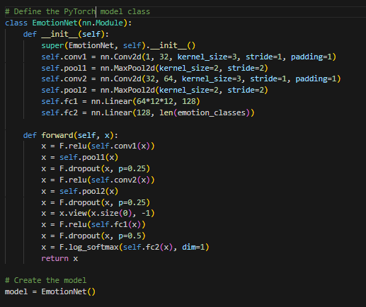
Some Sample Code - (PyTorch)

Slide 18
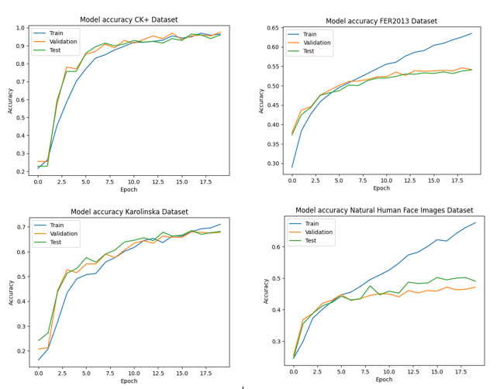
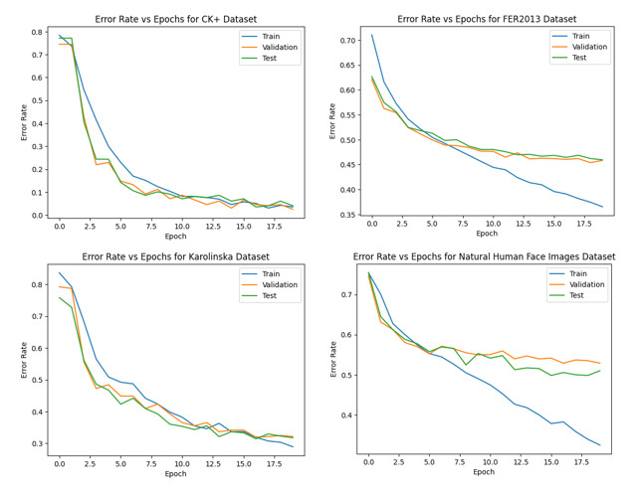
Result Analysis - TensorFlow
Accuracy Plots
Error Rate Plots

Slide 19
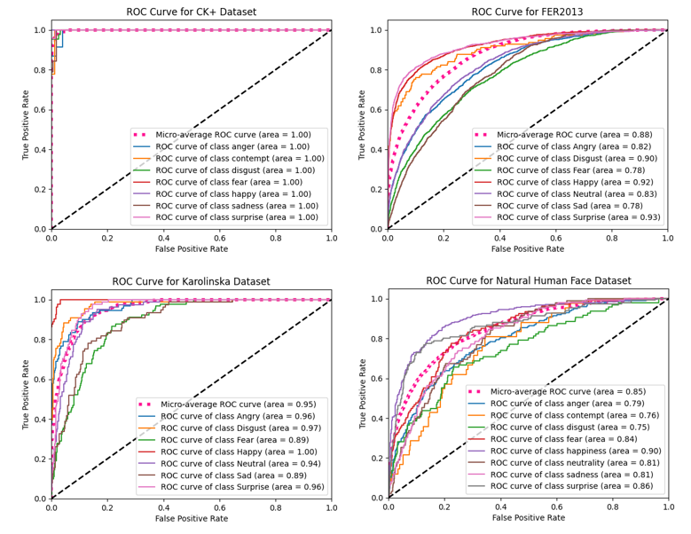
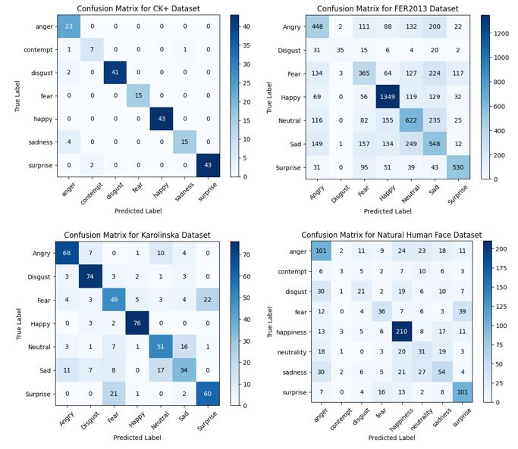
Result Analysis - TensorFlow
Confusion Matrices
AUC ROC Plots

Slide 20
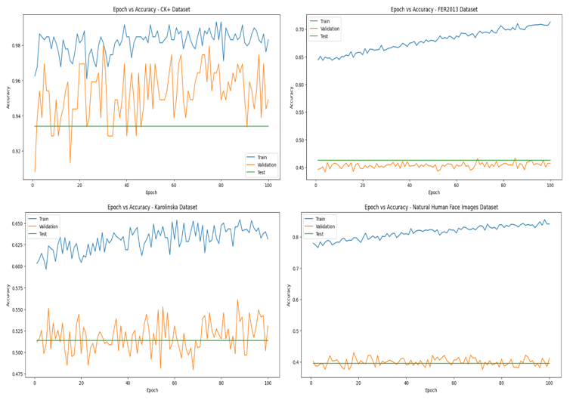
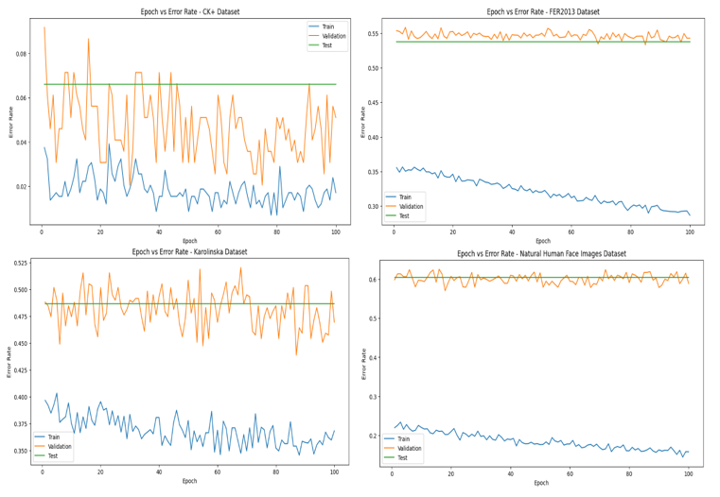
Result Analysis - PyTorch
Accuracy Plots
Error Rate Plots

Slide 21
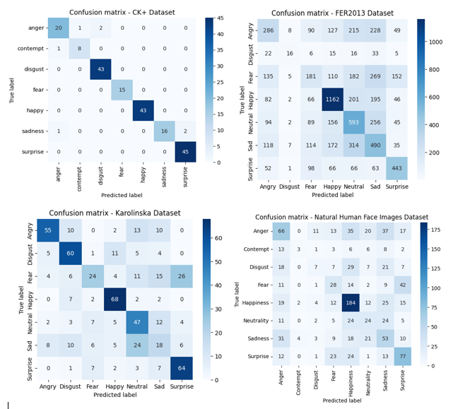
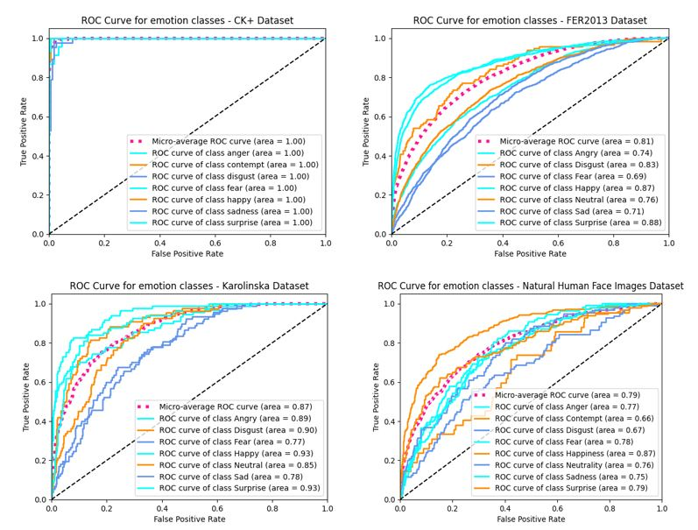
Result Analysis - PyTorch
Confusion Matrices
AUC ROC Plots

Slide 22
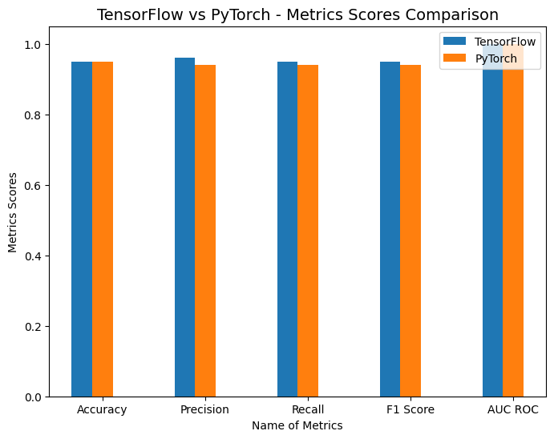
TensorFlow vs PyTorch (Metrics)

Slide 23
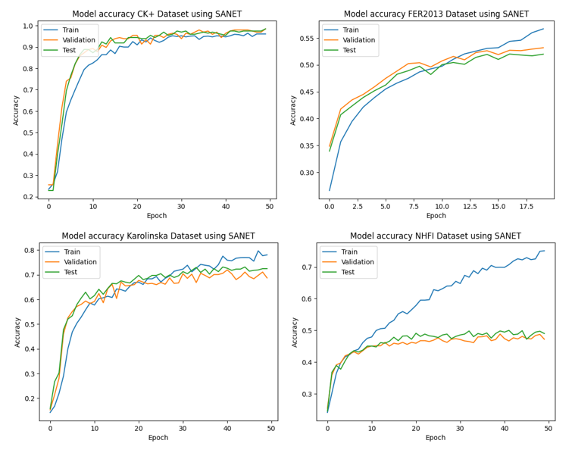
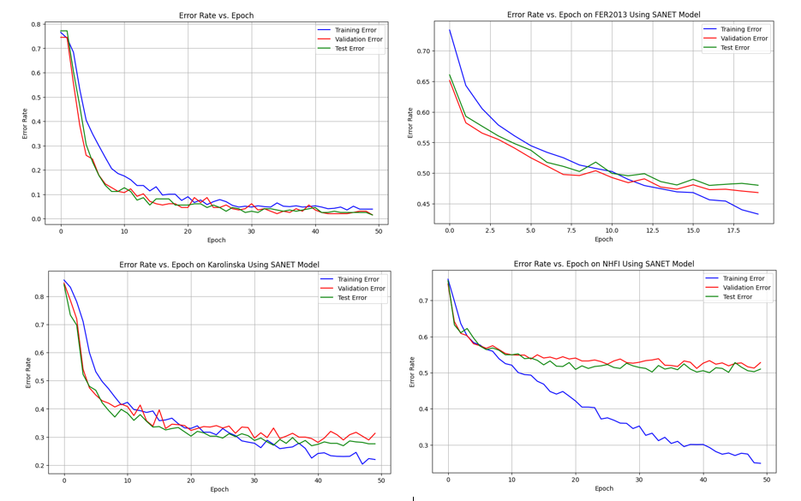
Result Analysis - SANet
Accuracy Plots
Error Rate Plots

Slide 24
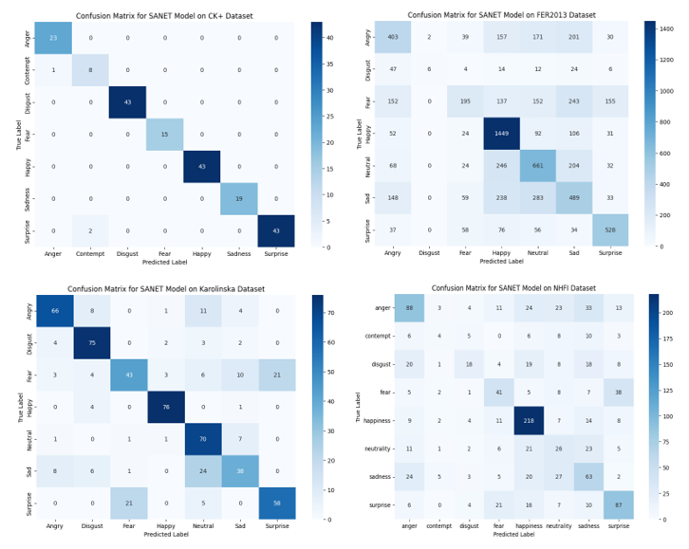
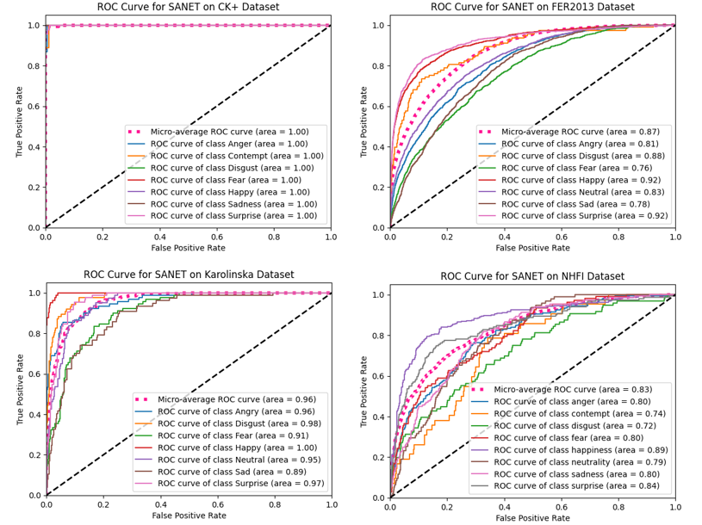
Result Analysis - SANet
Confusion Matrices
AUC ROC Plots

Slide 25
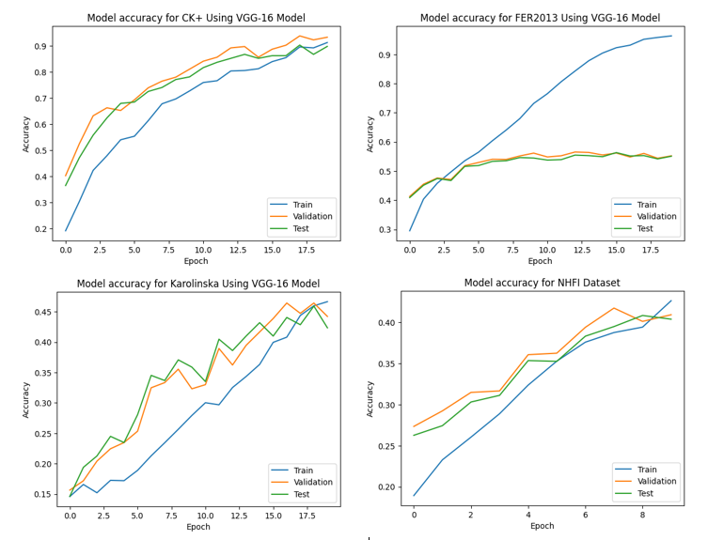
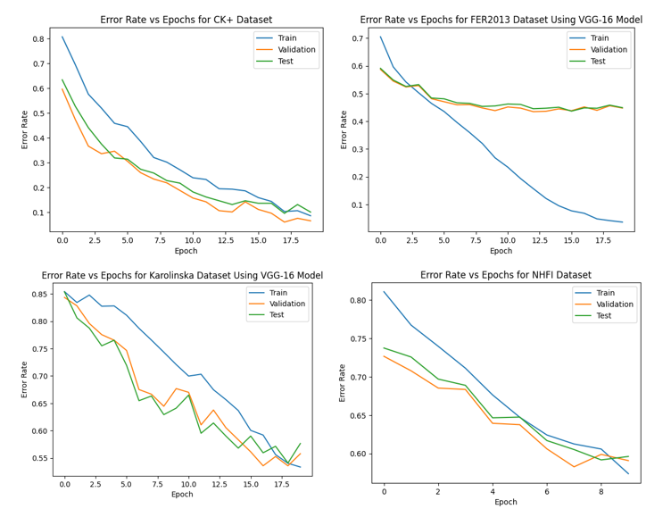
Result Analysis: VGG-16
Accuracy Plots
Error Rate Plots

Slide 26
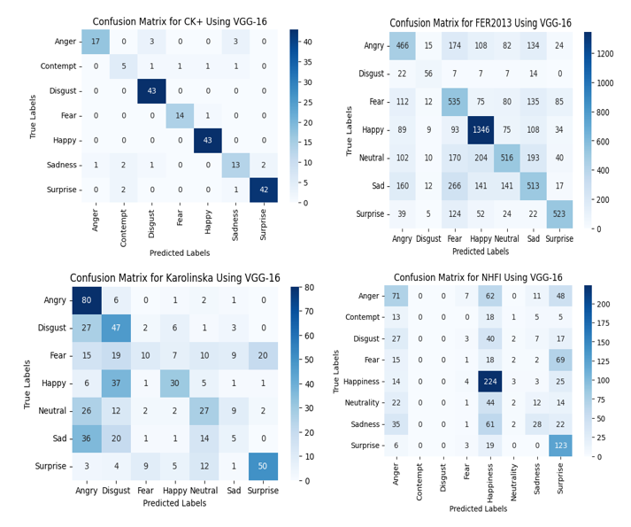
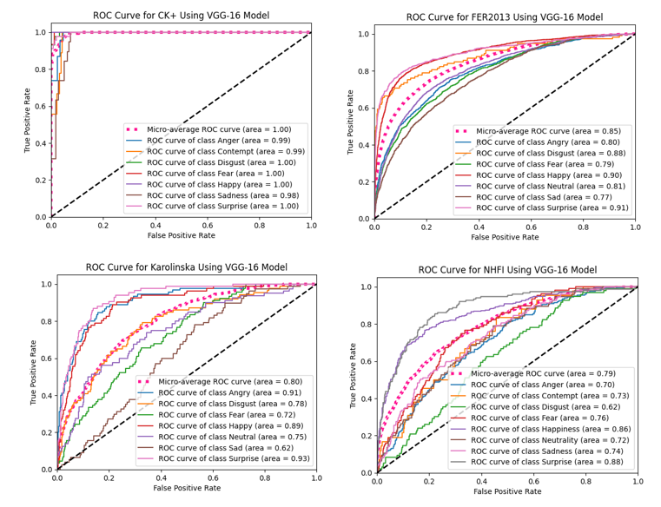
Result Analysis: VGG-16
Confusion Matrices
AUC ROC Plots

Slide 27
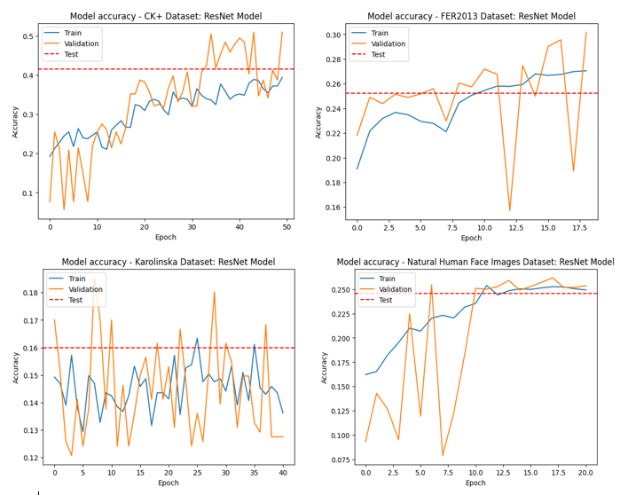
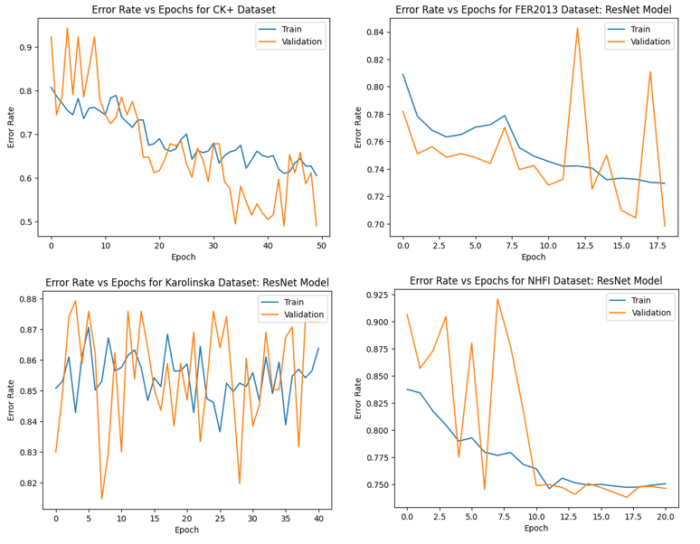
Result Analysis: ResNet50
Accuracy Plots
Error Rate Plots

Slide 28
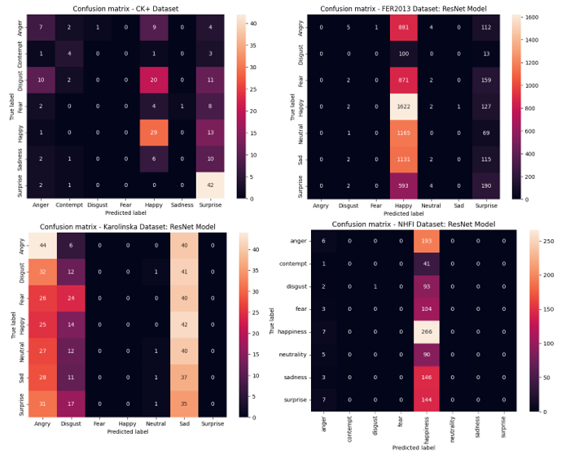
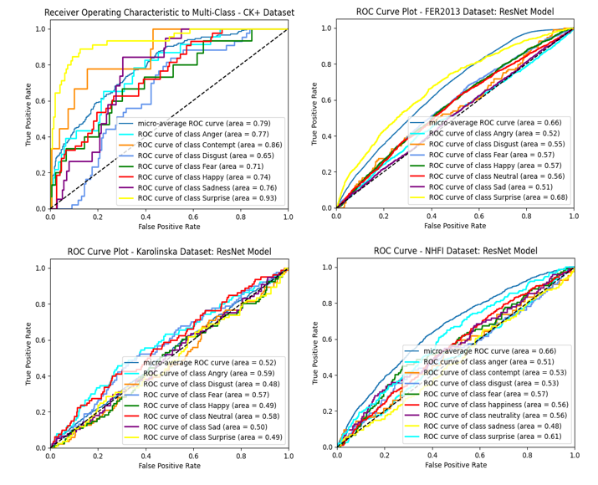
Result Analysis: ResNet50
Confusion Matrices
AUC ROC Plots

Slide 29
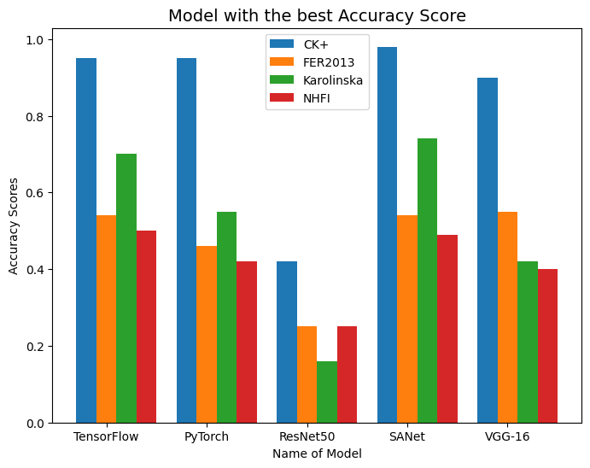
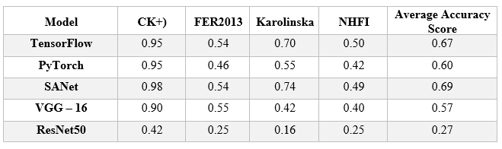
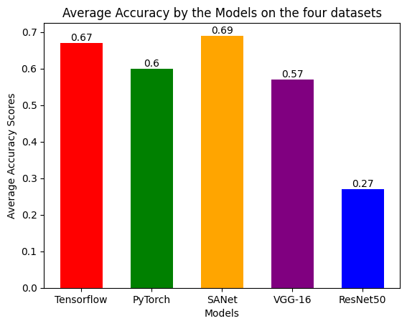
Result Analysis - Metrics

Slide 30
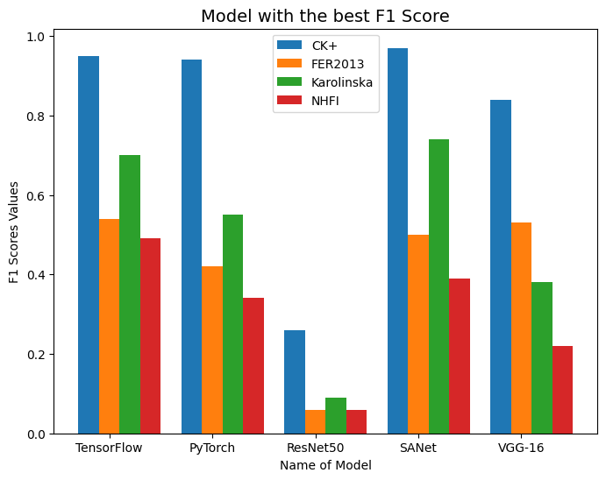
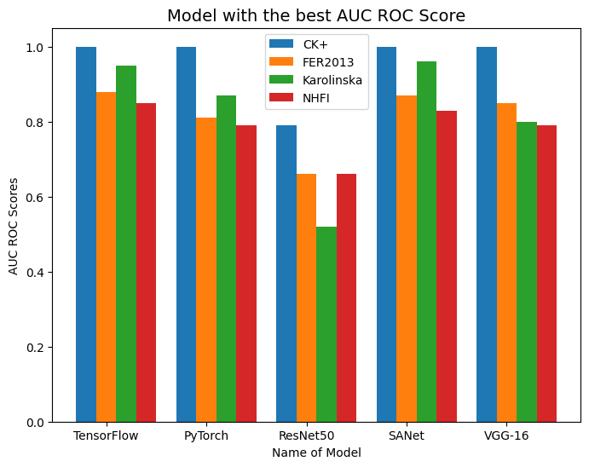
Result Analysis - Metrics

Slide 31
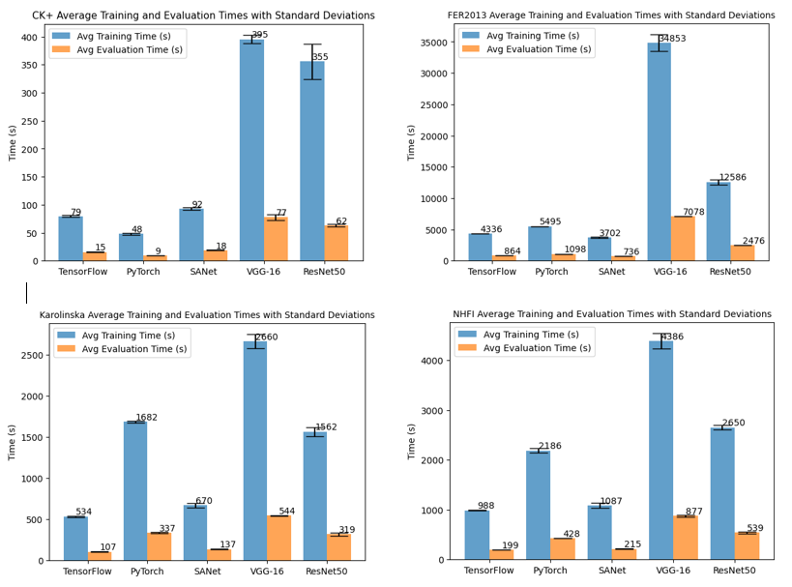
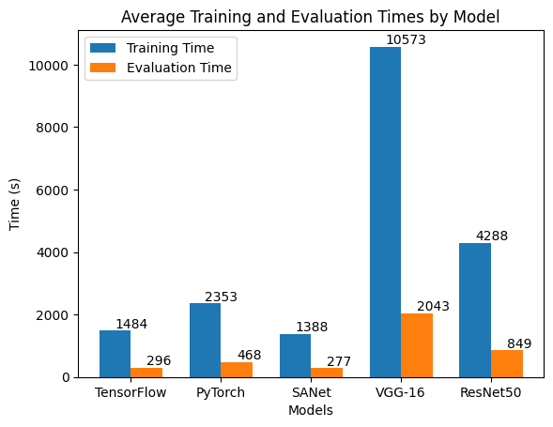
Result Analysis – Metrics (Training & Evaluation Time (s) Plot)

Slide 32
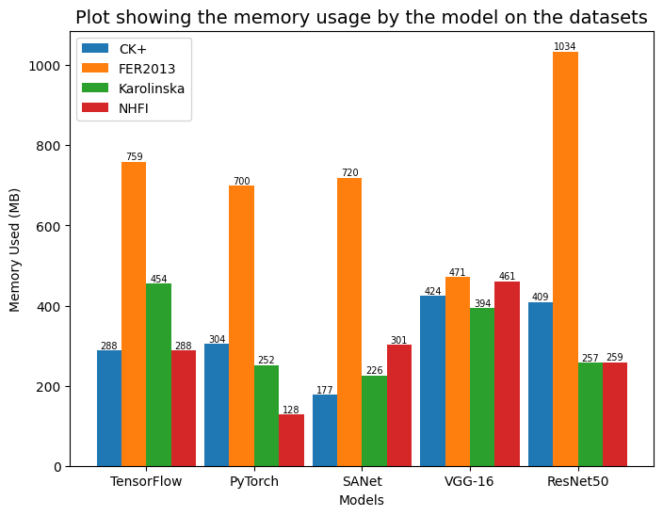
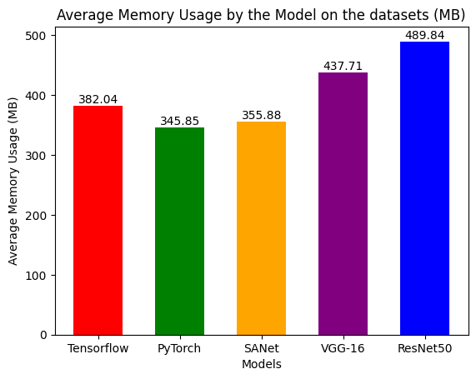
Result Analysis – Metrics (Memory Usage)

Slide 33
Remarks & Conclusions
The SANet model recorded the best accuracy training and evaluation time(s), while the PyTorch model obtained the best memory usage.
The Proposed model (TensorFlow & PyTorch) recorded a 95% classification accuracy using the CK+ datasets.
All five (5) CNN models used recorded the best accuracy using the CK+; this is not far from the rigorous annotation work done by the authors.
The ResNet model was the least-performing model across all metrics, whereas the NHFI dataset was the least-performing across all the models.
These Models are capable of performing emotion recognition when deployed into use.

Slide 34
Future Directions
Some more CNN models (AlexNet) and other datasets can be employed to see their performance on emotion recognition.
More hyperparameter tuning and data augmentation can be employed to improve the results obtained from these models, especially the ResNet Model.
The model's sensitivity to noisy or varied input data and its performance under real-world conditions in situations where the data may be more diverse and less controlled needs to be evaluated.

Slide 35
References
[1] Huang, ZY., Chiang, CC., Chen, JH. et al. A study on computer vision for facial emotion recognition. Sci Rep 13, 8425 (2023). https://doi.org/10.1038/s41598-023-35446-4
[2] Cîrneanu, A.-L., Popescu, D., & Iordache, D. (2023). New Trends in Emotion Recognition Using Image Analysis by Neural Networks, A Systematic Review. Sensors, 23(7092). https://doi.org/10.3390/s23167092
[3] L. Zhang, S. Wang, and B. Liu, “Deep learning for sentiment analysis: A survey,” WIREs Data Mining Knowledge Discovery, vol. 8, no. 4, Jul. 2018, https://doi.org/10.1002/widm.1253
[4] S. Afzal and P. Robinson, “Emotion Data Collection and Its Implications for Affective Computing,” in The Oxford Handbook of Affective Computing, R. Calvo, S. D’Mello, J. Gratch, and A. Kappas, Eds., Oxford University Press, 2015, p. 0. https://doi.org/10.1093/oxfordhb/9780199942237.013.002

Slide 36
Any Question?

Slide 37

Thank you for listening!

